Slide 1
Analyzing Crime Trends in Chicago: Insights
A data driven perspective on crime perceptions in Chicago
Zee Howard CS 322 NEIU Fall 2024

Slide 2
Why conduct this research? Because Fox News lies.
Objective:
Challenge the perception that Chicago is a dangerous city to live and work in.
Use data to uncover the actual likelihood of certain crimes
Research Question:
“How likely are thefts and motor vehicle thefts in Chicago, based on location and ward?”
Reasoning:
Let the data speak, not the narratives pushed on social media/news outlets

Slide 3
Key Project Points
Defining the focus:
-initially considered multiple crime types, but narrowed it down to theft and motor vehicle theft for clarity.
-decided to do a separate analysis for Primary Type, Location Description and Ward (challenge was to capture the data I needed, but to work with different ways crimes were described in the dataset)
Methodology:
Filtered dataset years due to big data size (focused on 2013-2023)
Used probabilities to analyze crime distribution, visualization to make sense of the trends

Slide 4
What I found (proof that Fox News skews the data)
Context:
This is just a partial snapshot of specific crimes committed in public places around Chicago from 2013 to 2023.
Overall Probabilities: (How likely are these crimes)
Theft: 68.7% of all relevant crimes used in this report
Motor Vehicle Theft: 31.3%
By Location:
Streets most common (74.7%), followed by small retail stores (11.2%) and sidewalks (6.6%)
By Ward:
The heatmap says Ward 1 is where most of these specific crimes are happening. Includes Wicker Park, Logan Square and West Town.

Slide 5
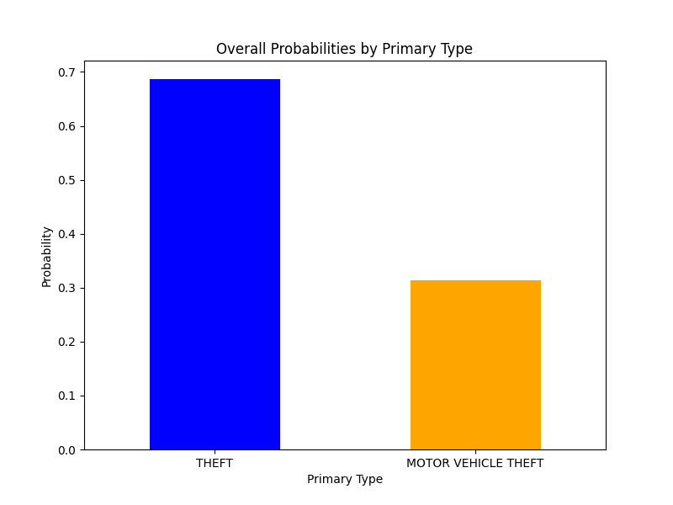
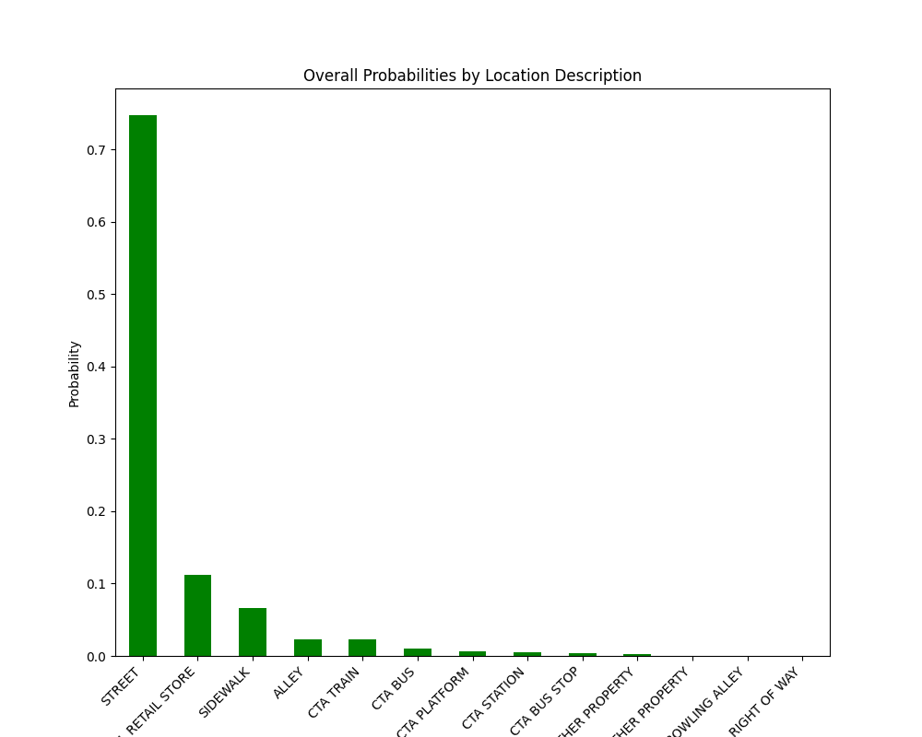
Visualizing the Data pt 1

Slide 6
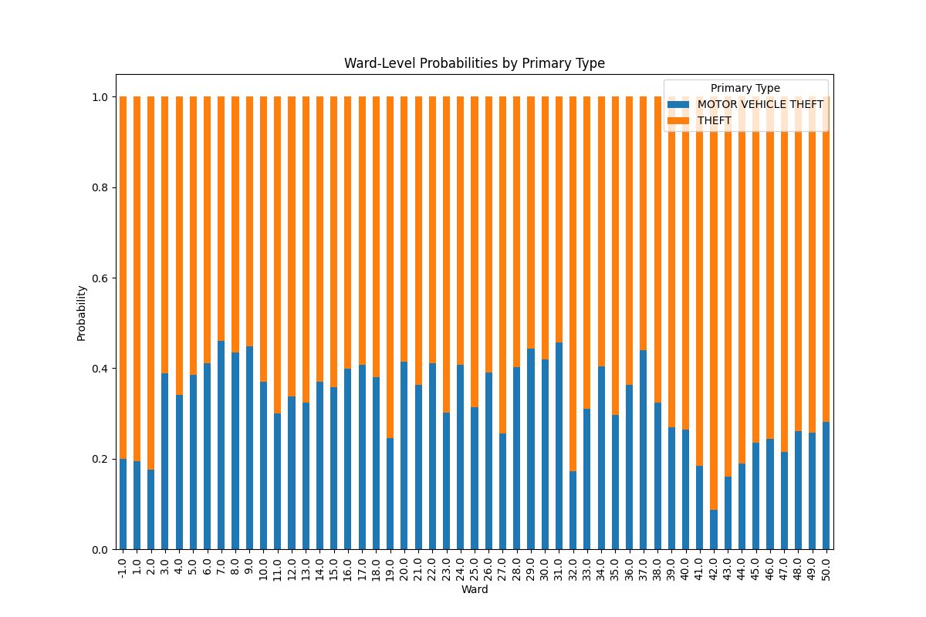
Visualizing the Data pt 2

Slide 7
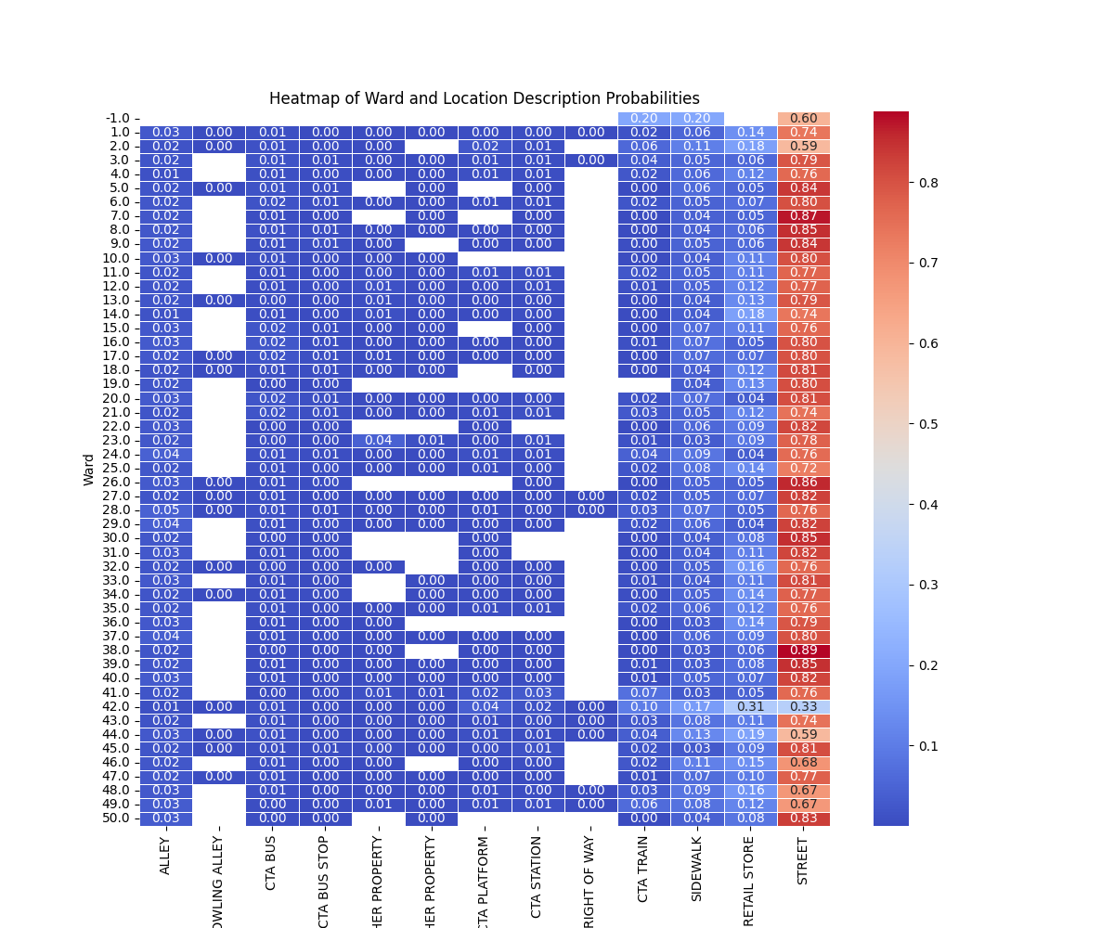
Visualizing the Data pt 3

Slide 8
Conclusions (that Fox News lies about Chicago crime)
-Crime isn’t as bad as certain news outlets make it out to be.
-However, just like in any city, exercise precaution. From personal experience, Ward 1 has a lot of late night bars/shows along Milwaukee Ave. Exercise caution especially from the hours of midnight to 6 am. Residents in Ward 1 have taken to hiring a private police force to deal with the theft in the area, especially car theft.
-Be careful in these streets at night.
-Understanding the context is key in providing insights from data, something Fox News doesn’t do.
-Don’t let anyone lie on Chicago. It’s the greatest and I used to live in NYC, so I know.

